Slide 1


Talend For Data Integration
Getting started
Data sources and metadata
Working with files
Basic manipulation with data flow
AUTHOR: SERGEY MOUKAVOZTCHIK
January, 2018

Slide 2

TRAINING STRUCTURE
1
Introduction & Talend basics
2
Databases & Internet components
3
Execution Control
4
Java Codding and Talend internals

Slide 3

TRAINER
4+ years with EPAM
6+ years of Talend experience

Slide 4
AGENDA
Talend overview and architecture
Working with files
Data sources and metadata
Basic manipulations with data flows
Notes:
Getting started
Talend overview and architecture
Starting with Talend Studio
Download and installation
Creating project
GUI overview
Creating a Job
Running a Job
Overview of components library
Types of connections between components
Data connections
Trigger connections and RunIf
Iterators
Repository
Talend documentation
Talend resources and blogs
Working with files
Reading and writing files
Files management
Iterating over files
File lookup using mask
Row count
Properties
Archive/Unarchive
Temporary files
Data sources and metadata
Creating metadata
“Build-in” and “Repository” mode
Defining a schema
Basic manipulatio with data
Joining data sources, capturing rejects, etc.
tMap (joining, filtering, outputing data, embeding java code)
Filtering data
Other processing operations
Exporting and Importing sources

Slide 5
HISTORY
Talend was founded in 2005
Talend is the first commercial open source data integration software
Talend v1.0.0 Open Source issued at October 2006
Many times was positioned as a Visionary in Gartner's Magic Quadrant
Talend had its IPO on NASDAQ on July 29, 2016
Talend current version is 6.4
Talend paying customers are more than 1,300 organizations

Slide 6
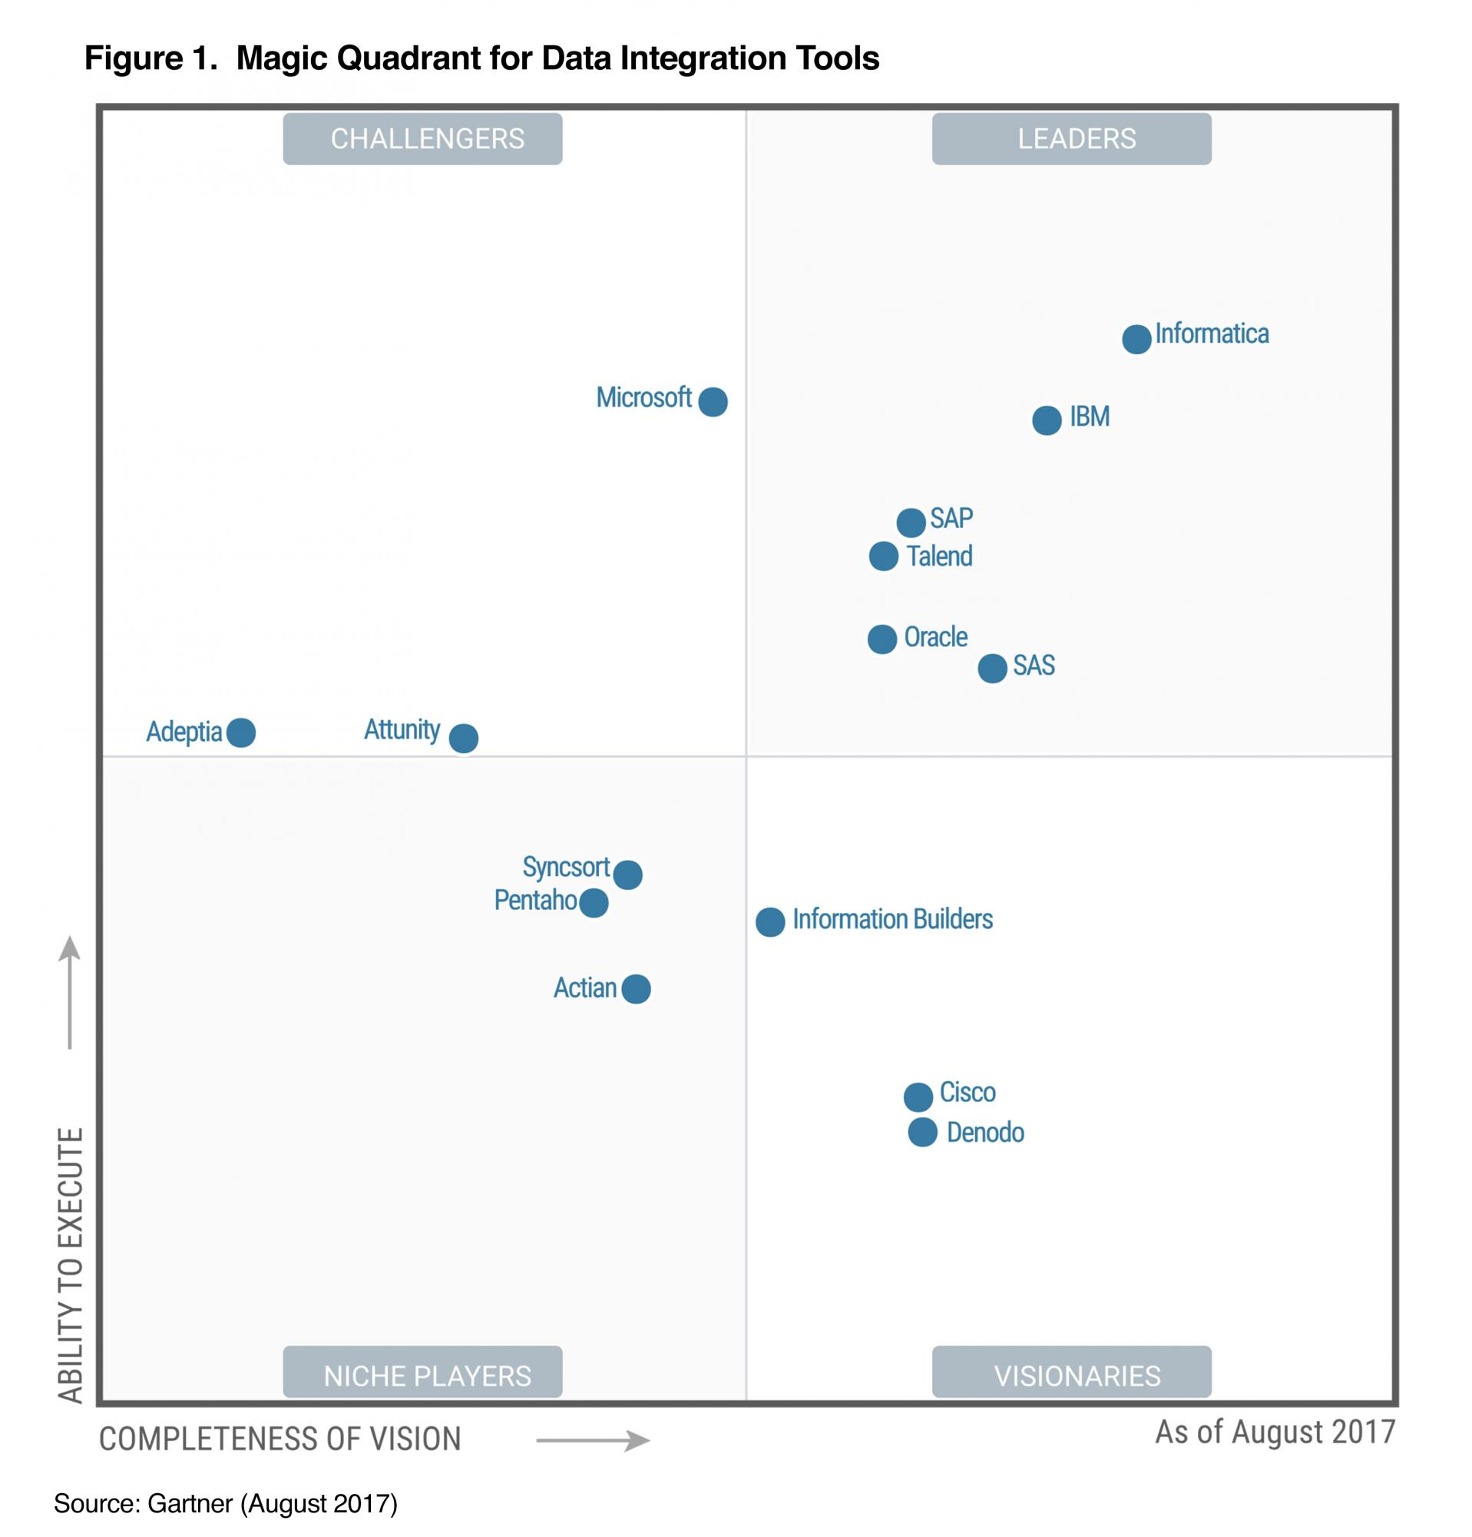
Gartner's Magic Quadrant 2017

Slide 7
STRENGTHS
Comprehensive portfolio of data integration and related technology
Cost model and flexibility
Free version availability
Commitment to evolving trends
Strong community
Documentation

Slide 8
WEAKNESSES
Product stability
Performance issues
Difficulties for nontechnical users
No single approach for components design and UX

Slide 9
TALEND PORTFOLIO
Commercial Products:
Data Fabric
Big Data Integration
Real Time Big Data
Data Preparation
Data Integration
Cloud Integration
Data Quality
Application Integration
Master Data Management
Metadata Manager
Free Products:
Data Preparation
Talend Open Studio
Open Studio for Big Data
Open Studio for Data Integration
Open Studio for Data Quality
Open Studio for ESB
Open Studio for MDM

Slide 10
Talend Data Integration

Slide 11
Starting with Talend Open Studio
Download and installation
Creating project
GUI overview
Creating a Job
Running a Job
Overview of components library
Types of connections between components
Repository

Slide 12
GUI overview
Repository lists all project items such as Jobs, code, metadata, and etc.
Design Workspace here you can design your jobs using components.
Palette lists all available components, organized in folders.
Configuration Tabs:
Component displays all parameters to configure a component
Run used to run a job and configure a job execution
Context used to manage context variables
Job use to configure global settings of a job
Palette contains components used to build jobs, grouped into several sections

Slide 13
Creating a Job
In Integration perspective is selected (in TOS for DI it is default one)
In the Project Repository, right-click Job Designs
Click Create Standard Job
Fill in Name, Purpose, Description fields
To close the wizard and create the job, click Finish

Slide 14
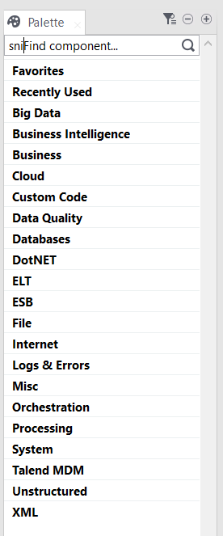
Overview of components library
Talend products has 1000 components
Connectors for more than 30 DBMS
Connectors for most popular cloud services
Components for work with number of applications from 3rdparty vendors
And many more….

Slide 15
Types of connections between components
Row
Main
Iterate
Trigger
OnSubjobOk
OnSubjobError
OnComponentOk
OnComponentError
Runif

Slide 16
Working with files
Reading and writing files
Files management
Row count
Properties
Archive/Unarchive
Temporary files
Iterating over files
File lookup using mask

Slide 17
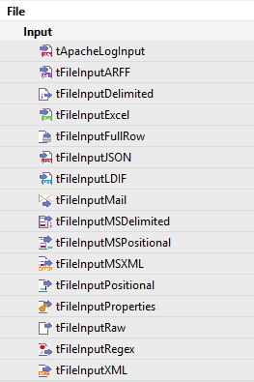
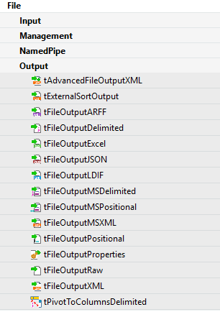
Reading and writing files

Slide 18
tFileInputDelimited tFileOutputDelimited
tFileInputDelimited – opens a file and reads it row by row to split them up into fields then sends fields as defined in the Schema to the next Job component, via a Row link.
(see page 1126 of Components Reference Guide)
tFileOutputDelimited - outputs the input data to a delimited file according to the defined schema.
(see page 1237 of Components Reference Guide)

Slide 19
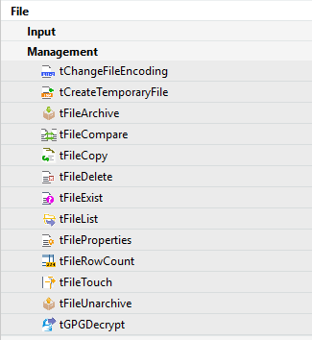
Files management

Slide 20
Iterating over files
tFileList - can be used in two ways:
To retrieve a set of files or folders based on a filemask pattern and iterate on each unity.
To iterate on files or folders of a set directory.
(see page 1222 of Components Reference Guide)

Slide 21
Data sources and metadata
Creating metadata
“Build-in” and “Repository” mode
Defining a schema

Slide 22
Basic manipulatio with data
Joining data sources, capturing rejects, etc.
tMap (joining, filtering, outputting data, embedding java code)
Filtering data
Other processing operations

Slide 23
USEFUL LINKS
Videos of webinar similar to this course can be found at:
https://videoportal.epam.com/search/results?q=Talend+DI
Also, here is a list of useful blogs and sites about Talend:
https://community.talend.com/
(pay attention to Tutorials: https://community.talend.com/t5/custom/page/page-id/Tutorials)
https://www.talendforge.org/
https://www.talendbyexample.com/
https://sites.google.com/site/bekwam/home/talend
http://www.vikramtakkar.com/
(https://www.linkedin.com/pulse/20141101170336-15611760-talend-certification-frequently-asked-questions-faq/)
http://talendhunter.blogspot.com.by/
http://www.robertomarchetto.com/category/blog/talend
http://blog.wdcigroup.net/blog/tag/talend/

Slide 24
Thanks for your attention!
Any questions?
AUTHOR: Sergey Moukavoztchik
Lead Software Engineer
January, 2018

